Slide 1
4. Digital Integrated Circuit Technology & Convertors

Slide 2
Lesson Plan
Introduction to Logic families (classification, parameters/chareacteristics). , Logic Gates using CMOS | 1
Design of Synchronous sequential circuits(counter and shift register) | 1
Concept of Moore and Mealy machines, Finite state machine design | 1
Sequence detectors | 1
DAC specs,types,Advantages and Disadvantages | 1
weighted resistor type, R-2 Ladder type | 1
ADC-specs ,types.Advantages and Disadvantages | 1
Flash type ,Successive Approximation type ,ICs like MC1408(DAC) ,ADC0808 | 1
Notes:
T1: Ramakant A. Gayakwad, Op-Amps and Linear Integrated Circuits. New Delhi: PHI, 4th Edition, 2015
T2: Salivahanan and V. S. Kanchana Bhaaskaran, Linear Integrated Circuits. New Delhi: McGraw Hill Education Pvt. Ltd, 2nd Edition, 2014

Slide 3
Introduction to Logic families
Using advance techniques, the complex circuits can be miniaturized and produced on a small piece of semiconductor material like silicon. Such a circuit is called integrated circuit (IC). Now-a-days, all the digital circuits are available in IC form. While producing digital ICs, different circuit configurations and manufacturing technologies are used. This results into a specific logic family.
Each logic family designed in this way has identical electrical characteristics such as supply voltage range, speed of operation, power dissipation, noise margin etc.

Slide 4
Significance of Logic Families
For the sake of simplicity in design and compatibility in constructing any complex digital system, all digital circuits (ICs) used in the design process should be from same logic family.
If the electrical IO characteristics of these logic circuits are not similar, there is a need to design an interfacing circuit to maintain the compatibility of digital logic ICs.

Slide 5
This interfacing circuit will match the electrical characteristics of the logic circuits. This ensures the compatibility for proper operation of the circuit.
In a logic family, the family members have similar electrical characteristics. Digital logic circuit has to be designed considering these compatibilities of different logic families in terms of different characteristics and parameters associated with the families.
Notes:
http://epgp.inflibnet.ac.in/epgpdata/uploads/epgp_content/S000574EE/P001494/M015062/ET/1459848747et01.pdf

Slide 6
Types of logic families
The group of ICs are fabricated using a specific circuit configuration which is referred to as a Logic family. The circuit design of the basic gate of each logic family is the same.
The logic family is designed by considering the basic electronic components such as resistors, diodes, transistors, and MOSFET; or combinations of any of these components

Slide 7
Table 1. Logic families and the components used for construction of logic family
Name of logic family | Components used
DL(Diode Logic) | Diodes
RTL(Resistor Transistor Logic) | Resistors and transistors
DTL(Diode Transistor Logic) | Diodes, transistors and resistors
TTL(Transistor Transistor Logic) | Transistors and resistors
ECL(Emitter Coupled Logic) | Transistors and diodes
PMOS(P channel Metal Oxide Semiconductor Logic) | P- MOSFETs
NMOS(N channel Metal Oxide Semiconductor Logic) | N- MOSFETs
CMOS(Complementary Metal Oxide Semiconductor Logic) | P –MOSFET and N-MOSFET

Slide 8
Logic families are classified according to the principle type of electronic components used in their circuitry
Logic families
Unipolar
PMOS
NMOS
Bipolar
Schottky TTL
CMOS
RTL
Non Saturated
Emitter coupled Logic
Saturated
DTL
TTL
DL, RTL and DTL are not very useful due to some inherent disadvantages while TTL, ECL and CMOS are widely used in many digital circuit design applications
Figure 1 Classification of logic families

Slide 9
TTL has an extensive list of digital functions and is currently the most popular logic family. ECL is used in systems requiring high-speed operations. MOS is used in circuits requiring a high component density, whereas CMOS is used in systems requiring low power consumption.

Slide 10
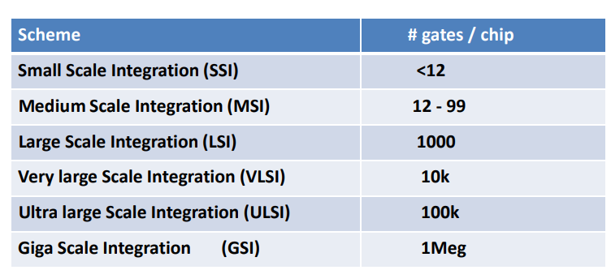
Logic Family/Level of Integration
Note: Ratio gate count/transistor count is roughly 1/10
IC logic gates fall under SSI, combinational logic circuits fall under MSI, and Microprocessor system come under LSI and VLSI.

Slide 11
Nomenclature of Logic family
The prefix of the part number represents the manufacturer code and the suffix at the middle denotes the subfamily of the ICs and suffix at the end denotes the packaging type.
For example: If the part number is S74F08N. The 7408 is the basic number used by all manufacturer for quad AND gate. The S prefix is the manufacture’s manufacture’s code for Signetics, F stands for FAST TTL subfamily, and the N suffix at the end is used to specify the plastic dual in line packaging

Slide 12
Suffix used for packaging:
N - Plastic dual in line package W - Ceramic flat pack D - Surface mounted plastic package
Prefix used for manufacturers:
S - Signetics SN - Texas Instruments DM - National Semiconductor
Suffix used for subfamily:
74H04 - High-speed 74L045- Low-Power 74S04 - Uses a Schottky Diode 74ALS04 - Advanced low power Schottky

Slide 13
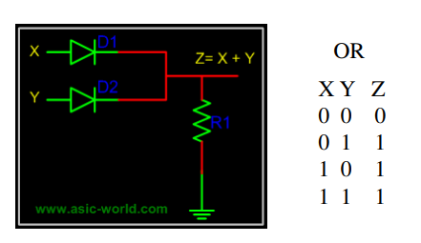
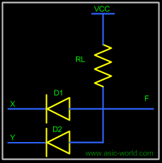
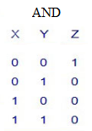
Diode Logic Family
In diode logic family, all the logic is implemented using diodes and resistors.
Diode Logic suffers from voltage degradation from one stage to the next.
Diode Logic only permits OR and AND functions, cannot perform a NOT function.
Diode Logic is used extensively but not in integrated circuits

Slide 14
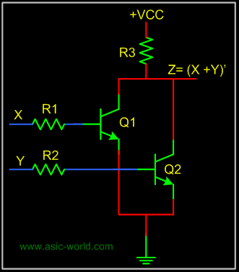
Resistor Transistor Logic (RTL) Family
A basic circuit of an RTL NOR gate consists of two transistors Q1 and Q2, connected as shown in figure above. When either of input X or Y is driven HIGH, corresponding transistor is goes to saturation and output Z is pulled to LOW.
X | Y | Z=( X+Y)’
0 | 0 | 1
0 | 1 | 0
1 | 0 | 0
1 | 1 | 0

Slide 15
RTL draw a significant amount of current from the power supply for each gate. Another limitation is that RTL gates cannot switch at the high speeds used by today's computers, although they are still useful in slower applications

Slide 16
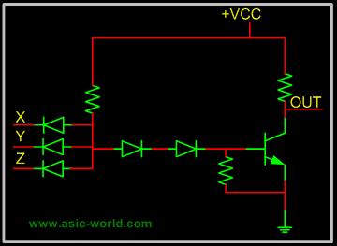
Diode Transistor Logic
Each of the input is associated with one diode. The diodes and the 4.7K resistor form an AND gate. If input X, Y, Z is low, the corresponding diode conducts current, thorough the 4.7K resistor. Thus there is no current through the diodes connected in series to transistor base . Hence the transistor does not conduct, thus remains in cut-off, and output out is High.
If all the inputs X, Y , Z are driven high, the series diodes conduct and thus driving transistor into saturation. Thus output out is Low

Slide 17
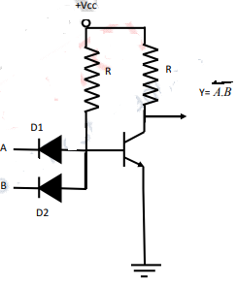
Diode Transistor Logic
In this circuit, diodes and transistors are fabricated into a single IC. When both inputs A and B is logic 0, diodes D1 and D2 are forward biased and the transistor is OFF. This is because, the emitter base junction of transistor is reverse biased and output Y is at logic 1. Hence, if one of the input is a logic 0 output Y is at logic level 1. On the other hand, if both A and B . are high, diodes are reverse biased and the transistor is ON and output Y is at logic 0. Therefore, this circuit behaves like simple NAND gate
A | B | Z=( A.B)’
0 | 0 | 1
0 | 1 | 1
1 | 0 | 1
1 | 1 | 0

Slide 18
Transistor Transistor Logic
Many versions of TTL family
Standard TTL.
High Speed TTL
Low Power TTL.
Schhottky TTL
TTL have three configuration at the output
Totem - Pole output.
Open Collector Output.
Tristate Output.

Slide 19
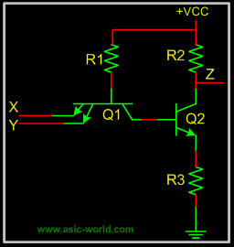
The input stage, which is used almost with all the versions of TTL. This consists of input transistor and phase splitter transistor. Input stage consists of multi emitter transistor as shown in figure. When any of the input is driven low, i.e. emitter base junction is forward biased and input transistor conducts. This in turn drives the phase splitter transistor into cut-off.
Multi-emitter input transistor is a striking feature of TTL logic family.

Slide 20
Totem Pole output
Below is the circuit of a totem-pole NAND gate,which has got three stages
Input Stage
Phase Splitter Stage
Output Stage
Output stage is called Totem-Pole because, the transistor Q3 sites upon Q4. Q3 and Q4 are stacked one above the other in such a way that while one of these conducts, the other is cut-off.
Q4 is called pull-down transistor, as it pulls the output voltage down, when it saturates and other is in cut-off (i.e. Q3 is in cut-off). Q3 is called pull-up transistor, as it pulls the output voltage up, when it saturates and other is in cut-off (i.e. Q4 is in cut-off).

Slide 21
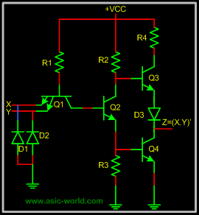
Diodes in input are protection diodes, which conduct when there is large negative voltage at input. Thus shorting the negative voltage to ground.

Slide 22
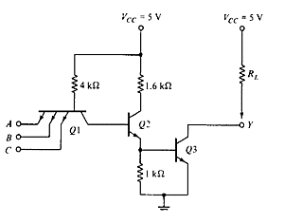
Open Collector Output
The main feature is that its output is 0 when low and floating when high. Usually, an external Vcc may be applied.

Slide 23
Transistor Q1 behaves as a cluster of diodes placed back to back. With any of the input at logic low, the corresponding emitter-base junction is forward biased and the voltage drop across the base of Q1 is around 0.9V, not enough for the transistors Q2 and Q3 to conduct. Thus the output is either floating or Vcc, i.e. High level.
Similarly, when all inputs are high, all base-emitter junctions of Q1 are reverse biased and transistor Q2 and Q3 get enough base current and are in saturation mode. The output is at logic low. (For a transistor to go to saturation, collector current should be greater than β times the base current).

Slide 24
Tristate Output
Below circuit is tri-state NAND gate, when Enable En is HIGH, below circuits works like any other NAND gate. But when Enable En is driven LOW. Q1 Conducts, and diode connecting emitter of Q1 and collector or Q2 conducts. Thus driving Q3 into cut-off. Since Q2 is not conducting, Q4 is also at cut-off. When both the pull-up and pull-down transistors are not conducting, out Z is in high-impedance state.

Slide 25
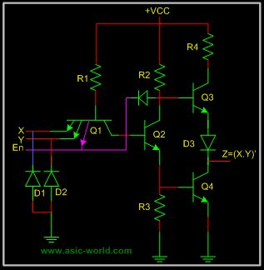
Tristate Output
Notes:
http://www.asic-world.com/digital/gates5.html

Slide 26
Depending upon the components used for fabrication, the digital ICs are classified into different families as TTL, CMOS and ECL. One has to use the same logic family for designing the logic circuit in order to avoid complexity in the circuit design and address the issue of compatability

Slide 27
Emitter-Coupled Digital Logic Gate
ECL uses bipolar transistor logic where the transistors are not operated in the saturation region, as they are with the standard TTL digital logic gate. Instead the input and output circuits are push-pull connected transistors with the supply voltage negative with respect to ground.
This has the effect of increasing the speed of operation of the emitter coupled logic gates up to the Gigahertz range compared with the standard TTL types, but noise has a greater effect in ECL logic, because the unsaturated transistors operate within their active region and amplify as well as switch signals.

Slide 28
Basic CMOS Digital Logic Gate
The main disadvantages with the TTL digital logic gate series is that the logic gates are based on bipolar transistor logic technology and as transistors are current operated devices, they consume large amounts of power from a fixed +5 volt power supply.
Also, TTL bipolar transistor gates have a limited operating speed when switching from an “OFF” state to an “ON” state and vice-versa called the “gate” or “propagation delay”. To overcome these limitations complementary MOS called “CMOS” (Complementary Metal Oxide Semiconductor) logic gates which use “Field Effect Transistors” or FET’s were developed.

Slide 29
As these gates use both P-channel and N-channel MOSFET’s as their input device, at quiescent conditions with no switching, the power consumption of CMOS gates is almost zero, (1 to 2μA) making them ideal for use in low-power battery circuits and with switching speeds upwards of 100MHz for use in high frequency timing and computer circuits.
This basic CMOS gate example contains three N-channel normally-off enhancement MOSFET’s, one for each input consisting of FET₁ and FET₂, and an additional switching MOSFET, FET₃ which is biased permantly “ON” through its gate.

Slide 30
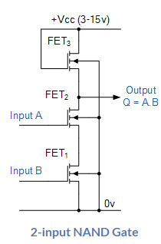
When one or both inputs “A” and “B” are grounded to logic level “0”, the corresponding input MOSFET, FET₁ or FET₂ are switched “OFF” producing a logic “1” (HIGH) output condition from the source terminal of FET₃.
Only when both inputs “A” and “B” are held HIGH at logic level “1”, does current flow through the corresponding MOSFET switching it “ON” producing an output state at Q equivalent to a logic level “0” as both MOSFETS, FET₁ and FET₂ are conducting. Therefore producing the switching action representative of a NAND gate function.
Notes:
https://www.electronics-tutorials.ws/logic/logic_1.html

Slide 31
Like TTL logic, complementary MOS (CMOS) circuits take advantage of the fact that both N-channel and P-channel devices can be fabricated together on the same substrate material to form various logic functions.
One of the main disadvantage with the CMOS range of IC’s compared to their equivalent TTL types is that they are easily damaged by static electricity. Also unlike TTL logic gates that operate on single +5V voltages for both their input and output levels, CMOS digital logic gates operate on a single supply voltage of between +3 and +18 volts.

Slide 32
Note that CMOS logic gates and devices are static sensitive, so always take the appropriate precautions of working on antistatic mats or grounded workbenches, wearing an antistatic wristband and not removing a part from its antistatic packaging until required.

Slide 33
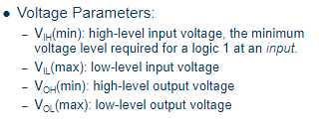
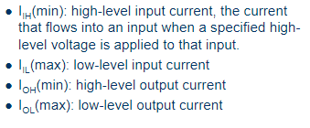
Digital IC Family Parameters Performance Parameters of logic families
Current Parameters

Slide 34
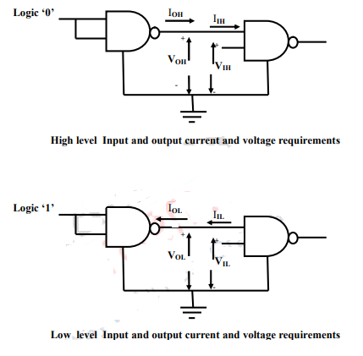

Slide 35
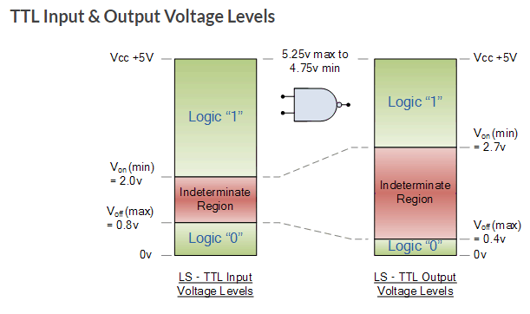
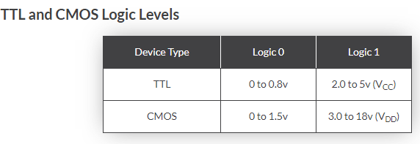

Slide 36
Performance Parameters of logic families
• Fan-out
• Input and Output Voltage level
• Noise Margin
• Rise and Fall time, and Propagation delay •Power Dissipation.

Slide 37
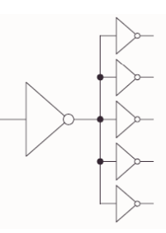
The fan-out of a subfamily is defined as the number of gate inputs of the same subfamily that can be connected to a single output without exceeding the current ratings of the gate. A typical fan-out for most TTL subfamilies is 10

Slide 38
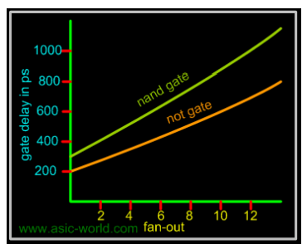
The fan-out really depends on the amount of electric current a gate can source or sink while driving other gates. The effects of loading a logic gate output with more than its rated fan-out will degrade the performance of the circuit. The gate delay increases with increase in fan-out

Slide 39
The output current capability for the HIGH condition is abbreviated IoH and is called source current. IoH for the 7400 is -400uA maximum. (- sign shows current is leaving the gate) The input current required under HIGH condition is abbreviated IIH and for 74xx subfamily is equal to 40uA maximum. Fan -out = 400/40 = 10
For the LOW condition, the maximum output current for the 74xx subfamily is 16mA, and the input requirement is -1.6mA maximum. The fan-out is usually same for both the HIGH and LOW conditions for 74xx subfamily; if not, we use the lower of the two. Because a LOW output level is close to 0V, the current actually flows into the output terminal and sinks down to ground. This is called sink current.

Slide 40
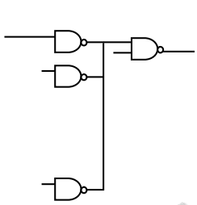
Fan in: This is the number of inputs of a logic gate. It is decided by the input current sinking capability of a logic gate as shown in Figure

Slide 41
. Power Dissipation: This is the power supplied required to operate the gate. It is expressed in milli-watt (mW) and represents actual power dissipated in the gate. It is the number that represents power delivered to gate from the power supply. The total power dissipated in the digital system is sum of power dissipated in each digital IC.
The power dissipation parameter for a logic family is specified in terms of power consumption per gate and is the product of supply voltage VCC and supply current ICC. The supply current is taken as the average of the HIGH-level supply current ICCH and the LOW-level supply current ICCL.

Slide 42
Rise time, tr: This is the time that elapses between 10% and 90 % of the final signal level when the signal makes a transition from logic LOW to logic HIGH.
Fall time, tf: This is the time that elapses between 90 and 10 % of the signal level when the signal makes a transition from logic LOW to logic HIGH

Slide 43
Propagation delay tp: The propagation delay is the time delay between the occurrence of change in the logical level at the input and before it is reflected at the output. It is the time delay between the specified voltage points on the input and output waveforms. Propagation delays are separately defined for LOW-to-HIGH and HIGH-to-LOW transitions at the output. In addition, we also define enable and disable time delays that occur during transition between the high-impedance state and defined logic LOW or HIGH states.

Slide 44
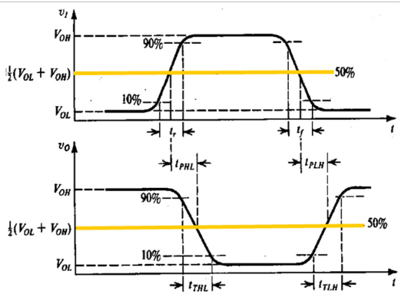

Slide 45
The propagation delay time is define as the average of low to - high (tPLH) propagation delay time and the high-to-low (tPHL) propagation delay time. propagation delay time t P = (tPLH + tPHL) / 2 The propagation delay time is directly proportional to the switching time and increases as the Fan-out increases.

Slide 46
It is the average transition delay time for a signal to propagate from input to output when the binary signals change in value. The signal through gate takes a certain amount of time to propagate from the inputs to the output. The interval of time is defined as the propagation delay of the gate. Propagation delay is expressed in nanoseconds(ns). The signals travelling from input to output of the system pass through a number of gates. The propagation delay of the system is the sum of the propagation delays of all these gates.

Slide 47
Speed–power product. The speed of a logic circuit can be increased, that is, the propagation delay can be reduced, at the expense of power dissipation.
When a bipolar transistor switches between cut-off and saturation, it dissipates the least power, but has a large associated switching time delay.
On the other hand, when the transistor is operated in the active region, power dissipation goes up, while the switching time decreases drastically.

Slide 48
Speed–power product
It is always desirable to have low values for both propagation delay, and power dissipation parameters.
A useful figure-of-merit used to evaluate different logic families is the speed–power product, expressed in picojoules, which is the product of the propagation delay (measured in nanoseconds) and the power dissipation per gate (measured in milliwatts).

Slide 49
Noise Margin
This is the maximum noise voltage added to the input signal of digital circuit that does not cause an undesirable change in the circuit output. There are two types of noise to be considered here
DC noise :This is caused by a drift in the voltage levels of a signal
AC noise: This is caused by random pulse that may be created by other switching signals.

Slide 50
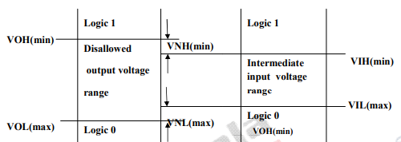
Noise Margin
Figure shows the generalized case of legal HIGH and LOW voltage levels for output.
The LOW output state can tolerate a positive voltage spike equal to (VIL(max.) − VOL(max)); and still be a legal LOW input.
The HIGH output state can tolerate a negative voltage spike equal to (VOH(min.) – VIH (min.)) and still be a legal HIGH input.
(VIL(max.) − VOL(max.)) and (VOH(min.) − VIH (min.)) are respectively known as the LOW-level and HIGH-level noise margin.

Slide 51
Noise-Margin measures how much external electrical noise a gate can withstand before producing an incorrect output. TTL will take anything below about 0.8 volt as a 0, and anything above about 2 volts as a high.
LNM (Low noise margin): The largest noise amplitude that is guaranteed not to change the output voltage level when superimposed on the input voltage of the logic gate (when this voltage is in the LOW). LNM=VILmax-VOLmax = 0.8V-0.4V = 0.4V

Slide 52
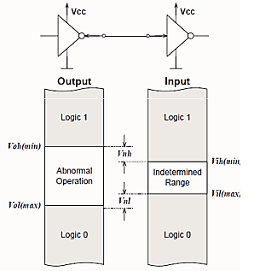
HNM (High noise margin): The largest noise amplitude that is guaranteed not to change the output voltage level if superimposed on the input voltage of the logic gate (when this voltage is in the HIGH). HNM=VOHmin-VIHmin = 2.4-2.0 = 0.4V

Slide 53
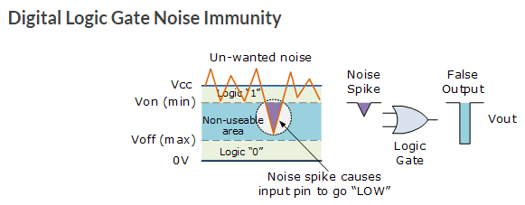

Slide 54
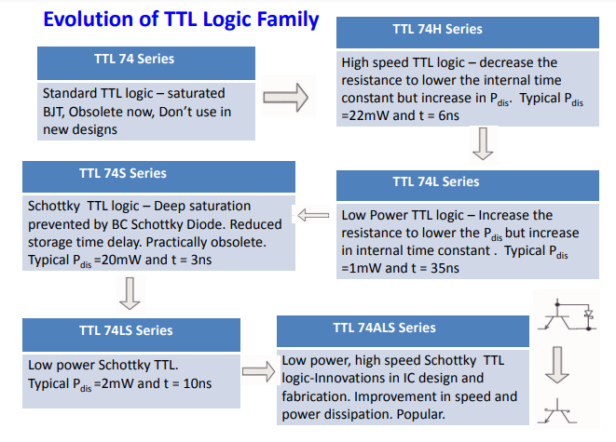
Advanced Low power Schottky
74F-Fast TTL

Slide 55
Comparision of TTL logic families

Slide 56
Comparsion of TTL and CMOS
Parameter | TTL | CMOS
Basic gate | NAND | INVERTER
Circuit | Transistor-Transistor | Complementary MOS
Speed of operation | More | Less
Propagation delay per gate | 4 - 12 ns | 50 ns
Nominal supply voltage | 5 V | 3 to 15 V
Wired collector capability | With passive pull up | With tristate output
Fan-out | 10 | 50
Noise immunity | Good | Very good to excellent
Compatibility with other families | With DTL | No, but compatible with TTL for 5 V supply
Available functions | Very high | High

Slide 57
Parameter | TTL | CMOS
Power Consumption | A single gate on a TTL chip can consume around 10mW of power. | An equivalent single gate in a CMOS chip can consume around 10nW.

Slide 58
Logic Gates using CMOS
Refer the write-up

Slide 59
Interfacing of logic families TTL to CMOS
Figure-1 depicts TTL to CMOS interfacing and CMOS to TTL interfacing circuits. When 5V supply is given to TTL and CMOS ICs, logic levels of TTL and CMOS are different. One TTL IC can drive any number of CMOS ICs. However, TTL output in 'high state' yields 2.4 Volt which is lower than the minimum voltage required by CMOS IC (which is 3.5V) . For TTL to CMOS interfacing, standard pull up resistor is connected which solves the interfacing problem as mentioned. This is shown in figure-1(a).

Slide 60
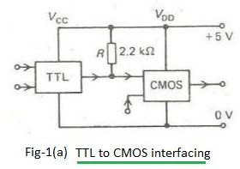
TTL to CMOS Interfacing

Slide 61
Interfacing of logic families CMOS to TTL
A CMOS IC can easily drive any low power schottky TTL IC directly. But to interface standard TTL IC, buffer is provided in between CMOS and TTL ICs. This is shown in figure-1(b).
The CMOS output can supply enough voltage and current to satisfy the TTL input requirements in the HIGH state, but TTL input current requirements at LOW state can not be met directly

Slide 62
Therefore, an interface circuit with a low input current requirement and a sufficiently high output current rating is required. A COS buffer serves this purpose.

Slide 63
